Slide 1
CLC 3
Ryan Coon Allen Atkins Carrie Assalone

Slide 2
Recursion Trees
Recursion Tree Method is a pictorial representation of an iteration method which is in the form of a tree where at each level nodes are expanded.
In general, we consider the second term in recurrence as root.
It is useful when the divide & Conquer algorithm is used.
It is sometimes difficult to produce a good guess. In Recursion tree, each root and child represents the cost of a single subproblem.
We sum the costs within each of the levels of the tree to obtain a set of pre-level costs and then sum all pre-level costs to determine the total cost of all levels of the recursion.
A Recursion Tree is best used to generate a good guess, which can be verified by the Substitution Method.

Slide 3
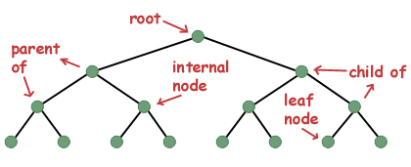
Parts of a tree

Slide 4
Three of most common ways to traverse a tree are known as in-order, pre-order, and post-order.
An in-order traversal visits each of the nodes in order
In a preorder traversal, we first print ourself, then we print all the nodes to the left of us, and then we print all the nodes to the right of ourself.
In a post-order traversal, we visit everything to the left of us, then everything to the right of us, and then finally ourself.

Slide 5
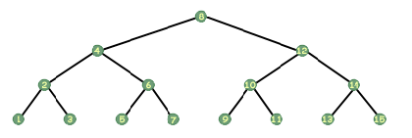
It may seem that the in-order traversal would be difficult to implement. However, using recursion it can be done in four lines of code.
void print_inorder(tree_t *tree) { if (tree!=NULL) { print_inorder(tree->left); printf("%d\n", tree->data); print_inorder(tree->right); } }

Slide 6
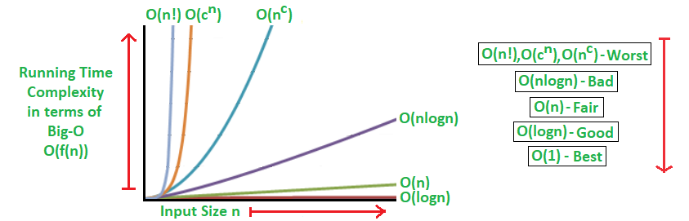
Trace Recursive Algorithms
Big O-Notation
Constant Time is “order 1” : 0(1)
Linear Time is “order 2” : 0(N)
Quadratic Time is “order N squared: 0(N^2)
Definition: Let g and n be functions from the set of natural numbers to itself.
if there is a Constant: f 0(g) c > 0
and a Natural Number n₀ such that
f(n) ≤ cg(n) for all n >= n₀ .

Slide 7
Trace Recursive Algorithms
Steps to BIG-O Notation analysis: “Find Run Time”
Figure out what the input is and what n represents.
Express the maximum number of operations, the algorithm performs in terms of n.
Eliminate all excluding the highest order terms.
Remove all the constant factors.
The BIG-O Analysis for any algorithm should be straightforward as long as the operations are correctly identified that are dependent on n, and the input size.
Fastest possible run time: 0(1) – Constant Running Time
Performance time depends on n, the size or input or number of operations for required for each input item.
Best Run Times Worst Run Times
O(logn) O(n^{c})
O(n) O(c^{n})
O(nlogn) O(n!)
T

Slide 8
Trace Recursive Algorithms
Ideal Algorithm – O(1) – Linear Search, Binary Search, Bubble Sort, Selection Sort, Insertion Sort, Heap Sort, Shell Sort.
Log Algorithm – O(log n) – Merge Sort.
Linear Algorithm – O(n) – Quick Sort.
Sub-Linear Algorithm – O(n+k) – Radix Sort.
Examples:
Logarithmic algorithm – O(log n) – Binary search
Linear algorithm – O(n) – Linear search
Superlinear algorithm – O(nlogn) – Heap sort, Merge Sort.
Polynomial algorithm – O (n^c) - Strassen’s Matrix Multiplication, Bubble Sort, Selection Sort, Insertion Sort, Bucket Sort.
Exponential algorithm – O (c^n) – Tower of Hanoi.
Factorial algorithm – O(n!) – Determinant Expansion by Minors, Brute Force Search algorithm for Travelling Salesman Problem.

Slide 9
Sorting Algorithm

Slide 10
Sorting Algorithm

Slide 11
Sorting Algorithm

